Slide 1
Install following software:
Chrome browser - www.google.com/chrome/
Node.js - nodejs.org
Git Bash - git-scm.com/downloads
VS Code - code.visualstudio.com/
Install http-server:
npm install –g http-server
6. Download repo: github.com/boris-nekezov/vuejs-basics-course
7. Vue.js devtools Chrome extension

Slide 2
VueJS Basics Course - Part 1 DOM Manipulation
Workshop by BorisNekezov

Slide 3
1. Who am I?
My name is Boris Nekezov
I work as Front-End developer in Trio Interactive
I have more than 4 years professional experience as one
Github: boris-nekezov

Slide 4
2. What is VueJS?
VueJS is a powerfull Front-End framework
Official site: vuejs.org
GitHub: github.com/vuejs/vue
VueJS allows you to create everything:
Small widgets driven by JavaScript which you drop into existing applications
Medium size applications where you control the whole page through JavaScript and rerender various parts making it very reactive
Big enterprise level single page applications
What is a single page application?
Single page applications have only one page index.html
When navigate is looks like you go through many different pages but actually it just loads dynamically other components
The page doesn’t reload at any point, although url can be updated to provide perception and navigability of separate logical pages in the application

Slide 5
3. History of VueJS
Vue was created by Evan You after working for Google using AngularJS in a number of projects.
He later said about his work on Vue: “I figured, what if I could just extract the part that I really liked about Angular and build something really lightweight”
Vue was originally released in February 2014.

Slide 6
4. The Future of VueJS
Maja Nowak December 19, 2018:
“With over 120k stars on GitHub, Vue.js is currently the trendiest JavaScript front-end framework, beating Angular and React in GitHub star count by a fair margin.”
“Vue might have started as a small project driven by developer needs of its creator, Evan You, but it has matured considerably over the years—becoming a full-fledged framework with a grownup ecosystem and developer tooling. Along the way, Vue attracted a decent number of contributors, sponsors, and evangelists.”
Currently at the moment: 30.01.2019
1st place VueJS 126,643
2nd place React 121,074
3rd place Angular 44,823
My conclusion is that VueJS has very bright future and will take a decent place among the other giants Angular and React.

Slide 7
5. Why choose VueJS over ANGULAR and REACT? Part 1
VueJS is extremely lean and small
16kb minified and gzipped for the core framework
Even With Vue Router it still stays very lean and small compared to Angular and React
VueJS is faster than Angular and React
It provides fast loading time
It also fast at runtime and with some benchmarks it even beats angular and react
It's very feature rich despites its small size
VueJS is the easiest one to learn
No need to learn TypeScript like Angular
Ne need to learn JSX like React
We do it just with plain JavaScript

Slide 8
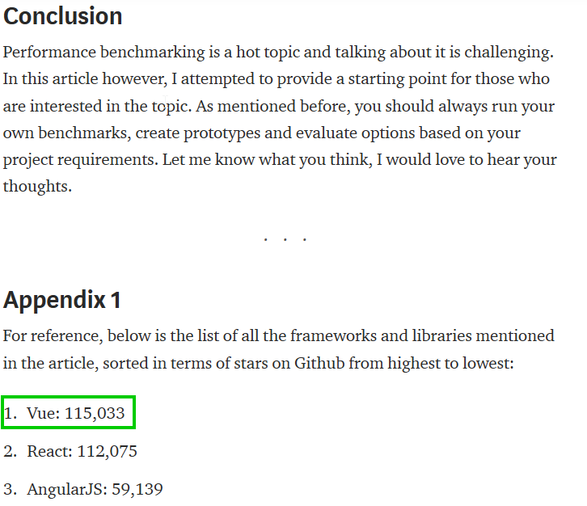
6. JavaScript Frameworks, Performance Comparison
Source:
https://medium.com/@ajmeyghani/javascript-frameworks-performance-comparison-c566d19ab65b

